Slide 1

Elkins & Ridge Point High School
12th Grade Parent Night Presentation
September 2023

Slide 2

Who am I
What do I do
Where am I located
When can you see me?

Slide 3

  Lead Counselor, Dina Powis
Last Names Sn - Z
Dina.Powis@fortbendisd.com
281-634-2613
Counselor, Kathleen Fey
Last Names A - Cha
Kathleen.Fey@fortbendisd.com
281-634-2607
Counselor, Richerica Wolf
Last Names Chb - G
Richerica.Wolf@fortbendisd.com
281-634-9843
Counselor, Ivy James
Last Names H - Le
Ivy.BowenJames@fortbendisd.com
Counselor, Elisha Carter
Last Names Li - Pao
Elisha.Carter@fortbendisd.com
281-634-2612
Counselor, Braiyon Sands
Last Name Pap - Sm
Braiyon.Sands@fortbendisd.com
281-634-2612
Counselor Clerk, Andrea Adams
Andrea.Adams@fortbendisd.com
281-634-3070
Counselor Clerk, Mary Sullivan
MaryE.Sullivan@fortbendisd.com
281-634-6257
Your EHS Counseling Team
ABOUT COUNSELING
Professional School Counselors are available at Lawrence Elkins High School to provide a Comprehensive Developmental Guidance Program and services for all students in the areas of:
Guidance Curriculum - In an effort to help students develop competence in essential life skills
Responsive Services - Provide intervention for immediate personal/social/emotional concerns
Individual Planning - Provide guidance to help students plan, monitor, and manage their personal, educational and career goals, and facilitate transition activities for post-secondary education and/or training
System Support - Support campus staff, parents, and community to promote the educational, career, personal, and social development of students, as well as the Developmental Guidance Program
EHS High School Code (CEEB) 446782
EHS SAT TEST CENTER CODE 44-845
EHS ACT TEST CENTER CODE 156760

Slide 4

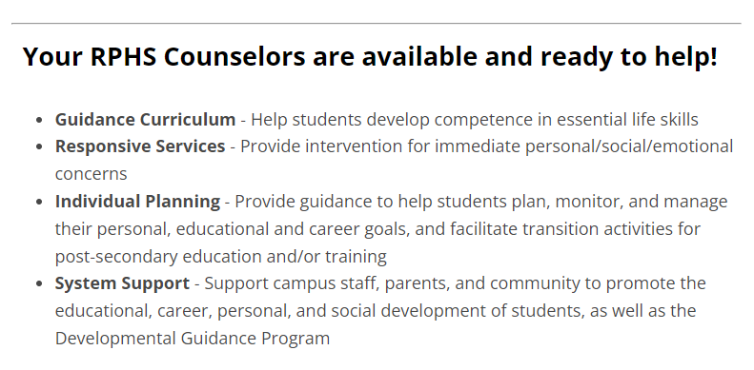







Your RPHS Counseling Team
Kaylynn Will, Lead Counselor (last names U-Z)
Melanie Blain-Tannous (last names A-C)
Brandi Goodly (last names D-He)
Tim Hemlin (last names Re-T)
Jill Tschetter (last names Martin-Ra)
Angela White (last names Hi-Marshall)
Andrea Garcia, Counselor Clerk

Slide 5

Important Changes for 2023-2024
in the world of FBISD CCR:
Shared CCMR Advisor Shared Model
SchooLinks replacing Naviance
Graduation requirements changes: FAFSA, & CPR
CCMR District-Wide Events :Pathways to Success: College, Career, and Military Readiness Event Series

Slide 6

Important CCMR Programming Dates:
August 29th & 31th : 12th Grade College Application & SchooLinks Workshop ( 4th Period) & 5th Period ( UT, PVAMU, U of H, Rice University will be here to assist 12th graders with their apps) – DONE/COMPLETED!!
September 6: Virtual Combined CCR & Counseling Department Elkins & Ridgepoint 11th (6pm) & 12th (7pm) grade parent meet. Look out for email invite.
October 17 (Elkins) 19 (Ridge Point): CPR, Peace Officer, & FAFSA Graduation requirements workshop ( 3rd & 4th periods)
October 24 ( Elkins) 25 (Ridge Point): ASVAB Exam offer on campus ( 10th-12th grades, 2nd – 5th periods)
This Photo by Unknown Author is licensed under CC BY-SA-NC

Slide 7

FBISD District-wide CCMR Events
* Save the Dates & Mark Your Calendars!

Slide 8
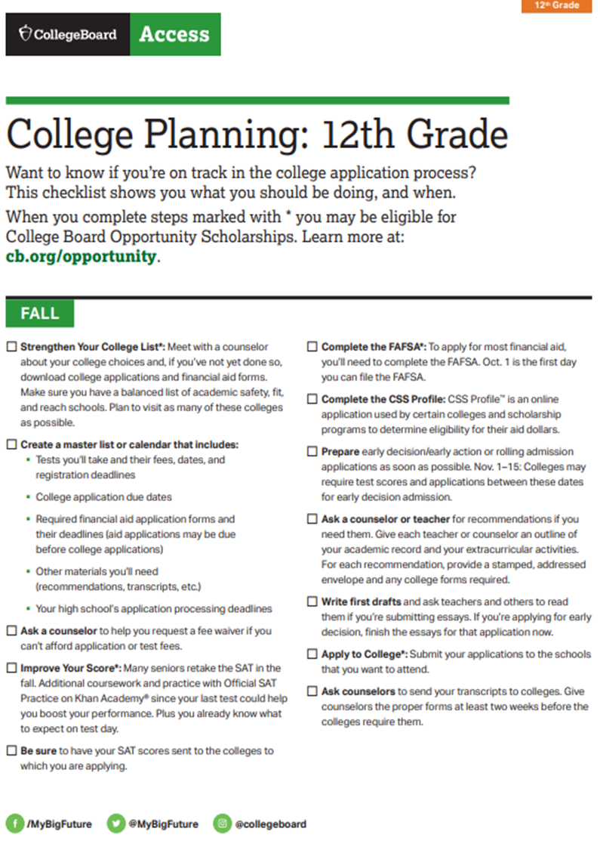
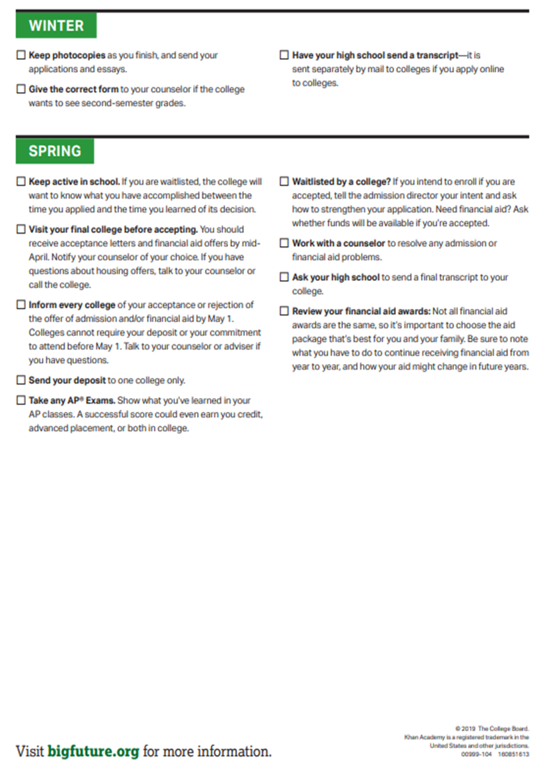
12th Grade CCMR
To Do List
by the Month

Slide 9


College Fit vs College Match
How are you selecting colleges to apply to?

Slide 10
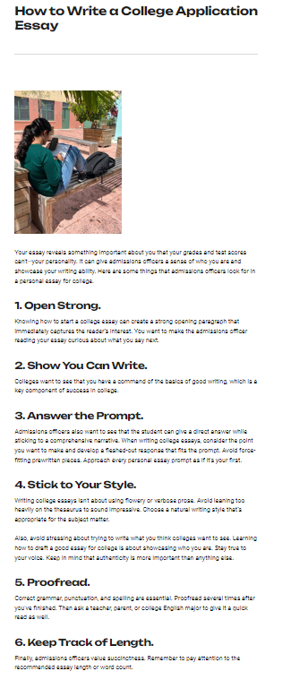


What to focus on until
September 15th?
12th grader - Write and rewrite your essays to represent you in rooms that your feet may never touch!
Have your 12th grader create an all-inclusive resume with all in-school and outside school, including sports, volunteer work, and work in their place of worship resume. No more than 2 pages. ( For scholarships and college apps, not letter of recommendation request)

Slide 11

Types of College App Deadlines
Rolling, Priority, & Regular
Early Action vs Early Decision
Rolling - Applications roll in & Decisions roll out
Priority - Equals $$ Scholarship consideration
Early Decision (binding)
Early Action (non-binding)
Restrictive Early Action - Students can only
apply to one school through early action, and all other colleges must be applied to through
Regular Decision or ED

Slide 12
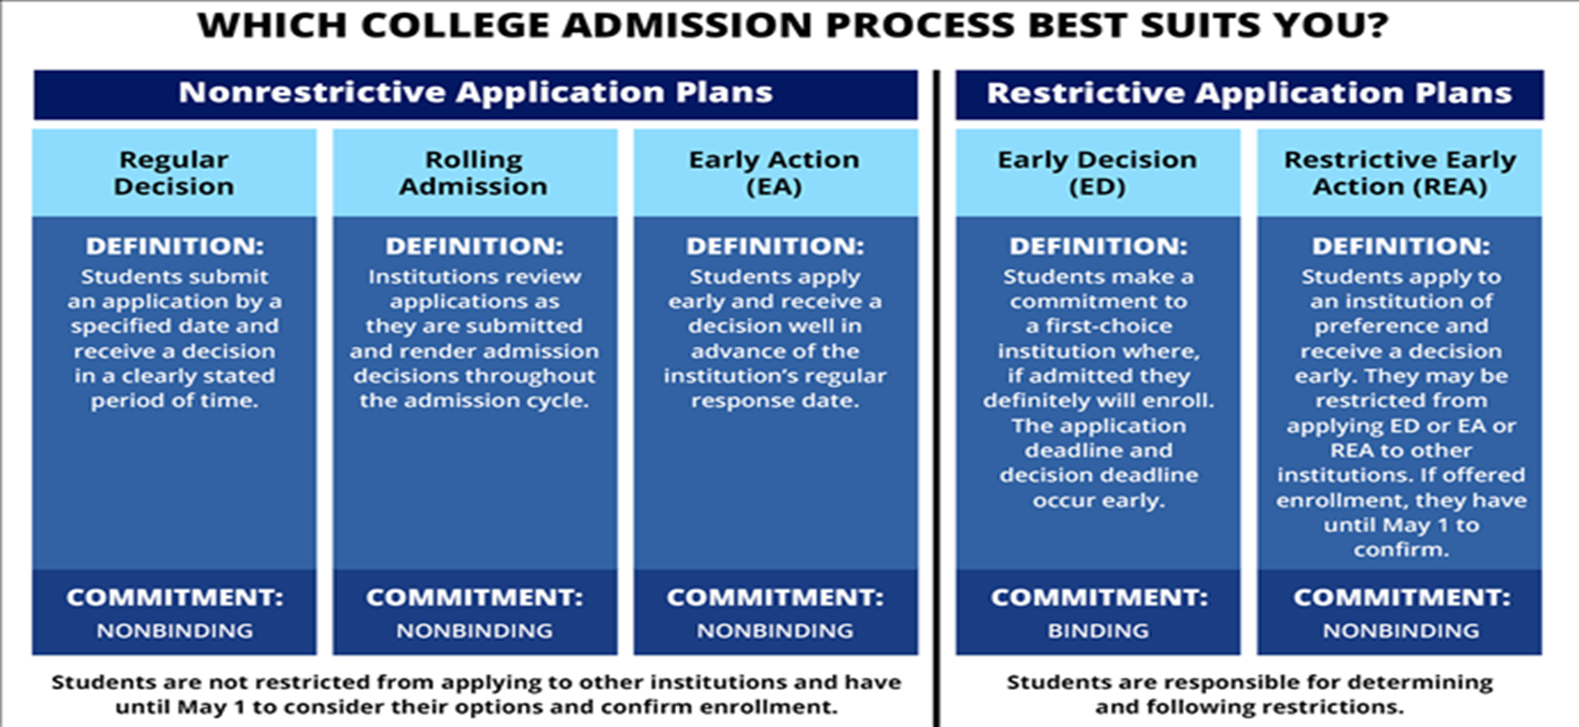

Slide 13




Types of College Apps Systems
Common App
ApplyTexas
Commonapp.org
  Many ApplyTexas colleges are also in CommonApp
  1st create CommonApp profile/application & then link via SchooLinks
  Consider completing all of your colleges apps. via www.Commonapp.org
ApplyTexas.org
  Public colleges in Texas and a few private colleges

Slide 14


Types of Colleges – Ivy, Private, Public, Etc.
Open Admissions, Technical, etc
Ivies – Public & Private, Selective Colleges

Slide 15
Important To Do’s From your Counselors
Graduation Plan
Classes taken outside of Elkins & Ridge Point
Have December Completion Due Date
Know and stay on top
TTU classes
UT classes
TxVSN
classes

Slide 16
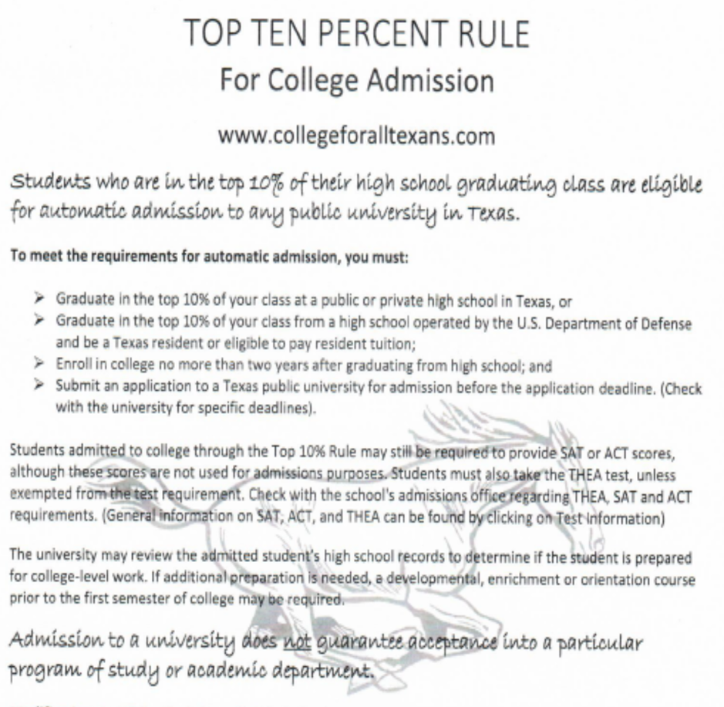
Auto Admit does NOT mean You Got your College Major

Slide 17
Tests, Tests, Tests – Do I need to send or NOT??
ACT vs SAT - Try to complete both or either by October to meet December 1st app. Deadlines.
SAT is NOT your only option
Many students do very well on the ACT
TSI – Offered 3 times this year
Optional
Blind
Look for the average test score
of those accepted and decide if you will
send
* Rule of thumb
If your score is lower than the
average admitted test scores for the
college that you are interested in
– Do NOT send test score
Use the gift of test optional

Slide 18
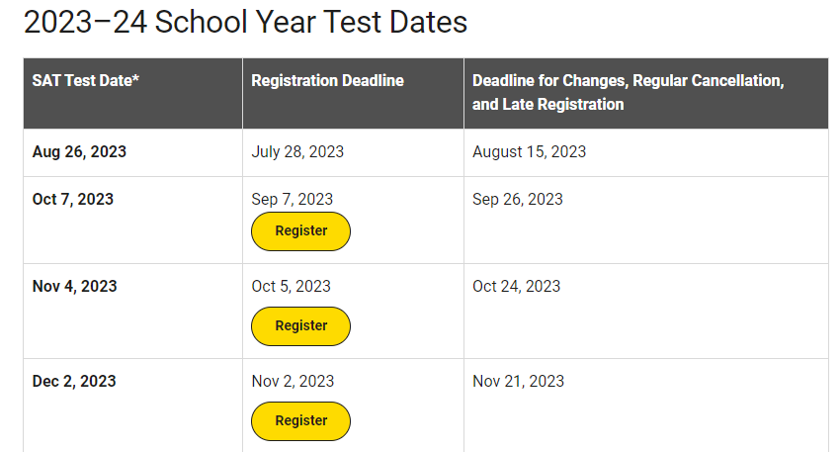
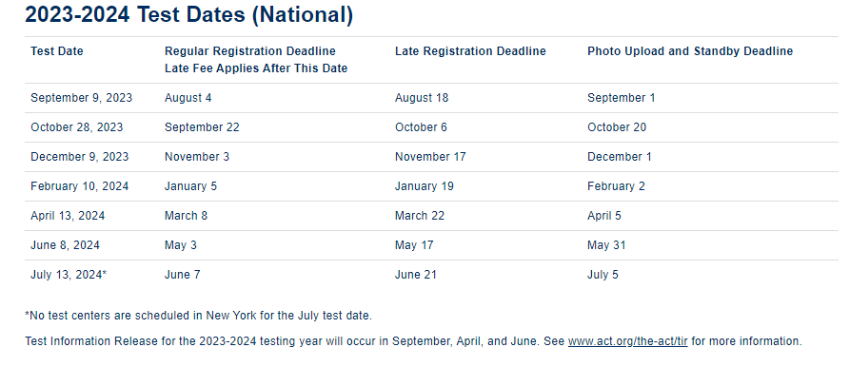
Register to take SAT & ACT
SAT Test https://mysat.collegeboard.org/login
ACT Test
www.ACT.org

Slide 19



SchooLinks:
All Things College & Career Ready
SchooLinks replaced Naviance
SchooLinks Overview
What is SchoolLinks?
New college and career readiness platform that allows students to explore, plan and realize their post secondary goals. Seniors will request transcripts for all college applications, and complete 5 more “senior tasks” in SchoolLinks
All Seniors must complete the initial onboarding process ASAP
To access SchoolLinks, scan here -→

Slide 20
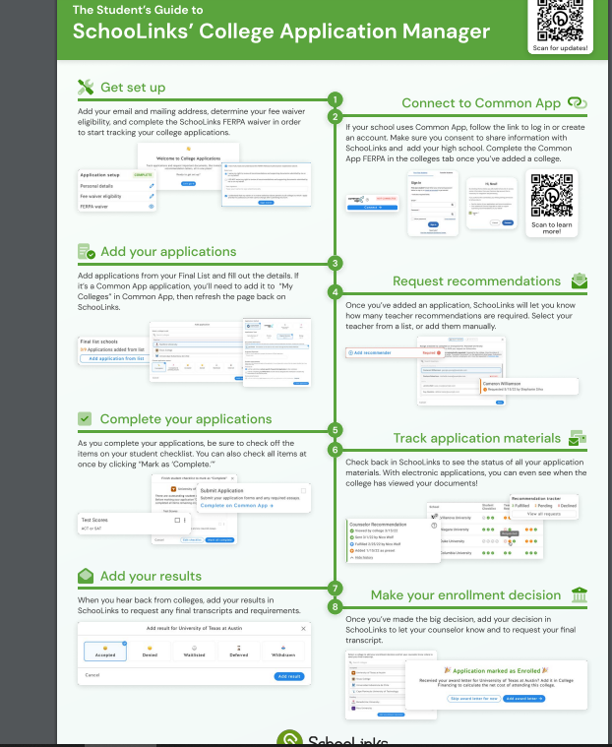

College Application Manager
College Application Manager
(order transcripts & connect application to CommonApp & SchooLinks)
What is College Application Manager?
The SchooLinks College Application Manager allows you to:
Track the progress and requirements for your college applications.
Organize of all the application materials for the colleges where you're applying.
Request your application materials including transcripts, letters of recommendation, etc. to be sent to the desired institution.
College Application Manager serves as an easy way to keep track of all the application steps and materials you need to submit to colleges and when you need to submit them, but it is not an application portal. You will need to submit applications using the methods offered by the colleges where you're applying.

Slide 21
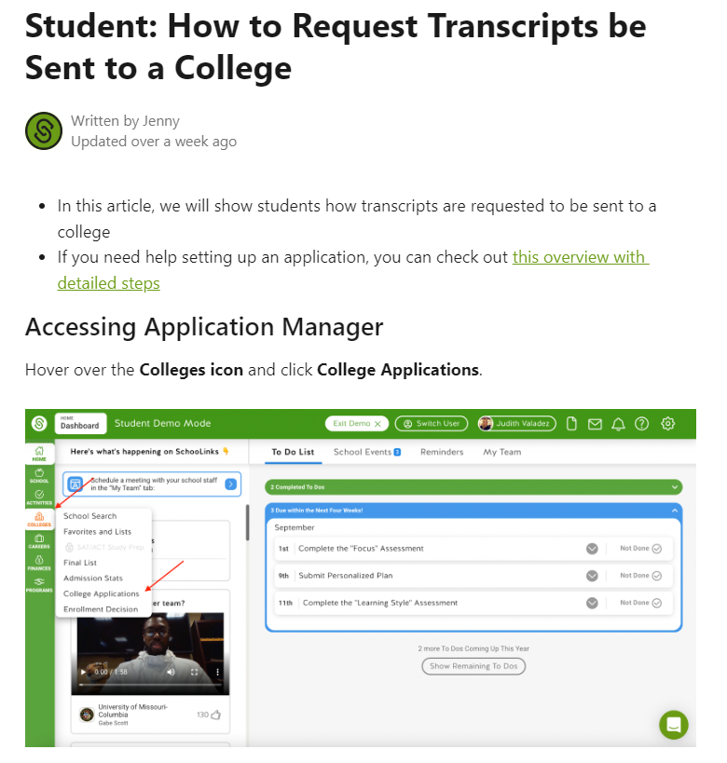

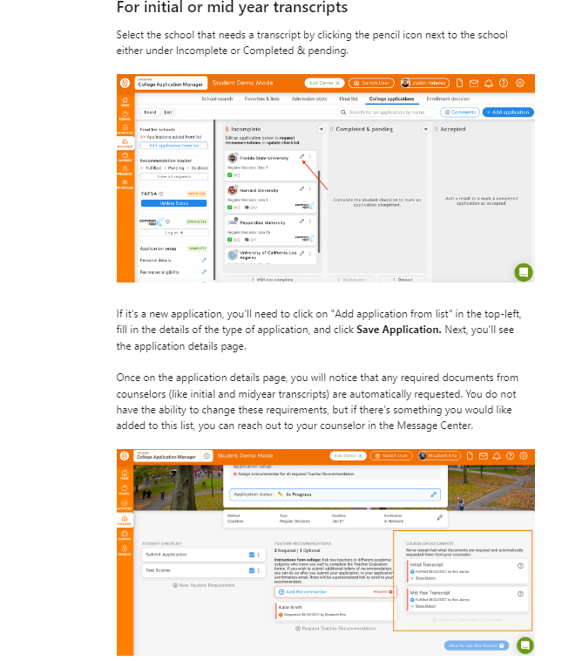
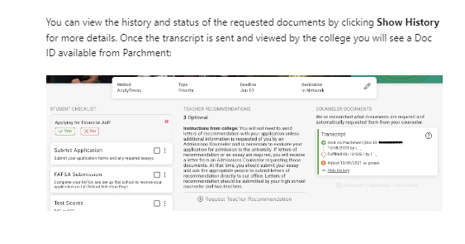
Letters of Recommendation - Request
Ask teacher and counselor in person
Submit letter of rec brag sheet to each recommender
Submit request in SchooLinks
Step 1
Step 2
Step 3

Slide 22

2 Excused Absence College visits this year
&
CCR Has 2 College Fieldtrips TBD
A student shall be excused for up to two (2) days during the student’s junior year and up to two (2) days during the student’s senior year to visit an accredited institution of higher education.
I suggest making 3 day weekends, 4 day weekends and allowing your student to attend 2-3 colleges visits in a day. This requires prior planning and connecting with current students and asking to shadow for an authentic experience.
A student shall be required to submit verification of such visit(s) by providing:
A letter from the university/college verifying the date(s) and purpose of the visit in order to be counted present for attendance accounting purposes. The same place you can schedule the college visit ahead of time on-line.
If a university/college verification letter is not submitted with in two (2) school days after the visit, the absence(s) will be considered unexcused.

Slide 23

Money, Money, Money, Money…for College, Career, Military.

Slide 24


Mandatory: FAFSA, CPR, Peace Officer
Other Graduation Requirements &
College/Scholarship Application Workshop :
Oct 17 (Elkins) & 19 (Ridge Point)
Oct 17 (Elkins) 19 (Ridge Point) Assembly
  - Tentatively 3rd & 4th Periods
District FAFSA Night- December 6, 2023 @ 6:00 pm –Virtual Event- more information is forthcoming!
State of Texas law that all graduating Seniors MUST complete the FAFSA/TASFA/Opt-Out form
  Start by creating a FSAID @ https://studentaid.gov/fsa-id/create-account/launch
Submit for verification to SchooLinks – Tutorial Forthcoming
Added to Official Transcript by the Registrar
*By completing an opt-out form, you are stating for graduation ONLY you are choosing NOT to complete a FAFSA/TASFA application. Student can STILL complete the FAFSA application.
FAFSA/TASFA Priority deadline has not been determined because the FAFSA application doesn’t open until December 1st this year.

Slide 25
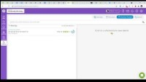

Finding Scholarships in SchooLinks

Slide 26


ROTC SCHOLARSHIPS
Military Branches – ROTC Scholarship
TAMU Corps of Cadets
If your seniors are interested in military service they can apply for ROTC scholarships online now, they pay tuition, academic fees, spending money and book allowance.
Army https://www.goarmy.com/rotc/scholarships.html
Air Force / Space Force https://www.afrotc.com/scholarships/high-school/types/
Navy / Marine Opens April 1 - https://www.netc.navy.mil/Commands/Naval-Service-Training-Command/NROTC/Apply/

Slide 27




Large Scholarships
Quest Bridge Scholarship App – Due Tuesday, Sept 26th
High-Achieving
Low-Income
Different National Scholarships
There are several scholarships for volunteering, community service, leadership and public service.
Coca-Cola Scholars Foundation Scholarships
Diller Teen Tikkun Olam Scholarship
Elks Most Valuable Student Competition
Equitable Excellence Scholarship
Harry S. Truman Scholarship
Taco Bell Foundation Live Más Scholarship
There are several scholarships for low-income students and students who are underrepresented in postsecondary education.
Dell Scholars Program
Horatio Alger Association Scholarship
Jack Kent Cooke Foundation
QuestBridge National College Match Scholarships
Sphinx Competition

Slide 28
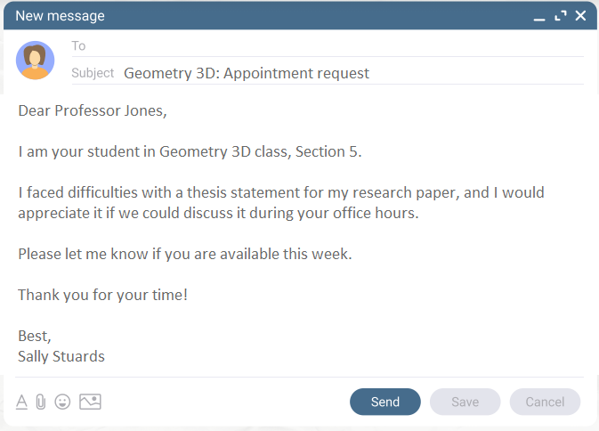
Email Etiquette
Who are you?
What school Do you attend?
What is your student ID#
Greetings
Contact info.
Communicate how you want
to be communicated to

Slide 29
Thank you for your attention!
The Elkins & Ridge Point HS’s CCR & Counseling team
wishes you the best as you assist your children in their post-high school pursuits!

Slide 30
FORT BEND ISD
16431 Lexington Blvd.
Sugar Land, TX 77479
281-634-1000
www.fortbendisd.com

